Slide 1

THERATTIL ANITTA SAJU DATA ENGINEER (4.5 years)

Slide 2
CONTENTS
ABOUT ME
TECH STACK
PROJECT 1
PROJECT 2
PROJECT 3
PROJECT 4
PROJECT 5
CERTIFICATIONS
ACHEIVEMENTS
CONTACT DETAILS
01
02
03
04
05
06
07
08
09
10

Slide 3
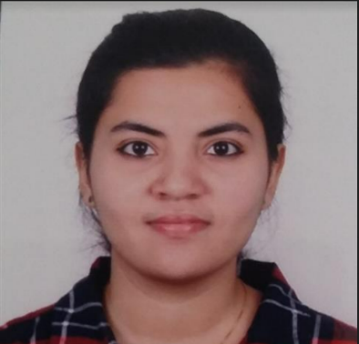





About Me
I have been consistently appreciated for my accountability, technical acumen, and out-of-box thinking by my peers and leaders throughout my 4.5 years of professional experience in the field of Big Data and Data Engineering. I am a quick learner, a proactive problem solver, and open to learning new platforms. I look forward to being a part of an organization that would help me grow and in turn help me use my skills to contribute to the company’s vision.
2017.09
2017.12
2019.12
2022.03
2022.04
Graduation
System Engineer
Senior Analyst – Product
Development
Immigrated
to Korea
Client

Slide 4











Tech Stack - I
Programming Languages
Database
Big Data
Data Presentation tools

Slide 5







Tech Stack - II
BI Tools
Other skills/Tools

Slide 6









Project 1 : Fraud Dashboard
Why ? :
To report key fraud metrics to senior leadership and strategic partners for daily insights into fraud trends
What’s new ? :
This is a daily interactive dashboard with monthly and YoY components which is also capable of interactively visualizing trends in different categories like markets and types of fraud across years.
Flow diagram :
Technology Used
Flow diagram :
Technology Used
Data processing using HQL
Data from csv is loaded into SQL tables
SSIS Job
Interactive Tableau dashboard is built on top of SQL tables
Source data from Hive warehouse
Aggregated data is written into csv

Slide 7





Project 2 : Authorization Reporting
Why ? :
To report key Authorization metrics to senior leadership and strategic partners for monthly insights into transaction authorization trends.
What’s new ? :
Input data has a high volume (~5 million records per day) with 30+ columns being used, and the size of the output file is ~80 GB per month after aggregations. Nevertheless, using multiple optimization techniques, monthly processing is completed within 3 hrs.
Flow diagram :
Technology Used
Daily aggregates
written into Hive
staging tables
Daily aggregation
with PySpark
Monthly aggregation
with PySpark
Aggregated data
written to csv
Source tables from
Hive warehouse
SSIS Job
Source tables
from Teradata
Warehouse
Imported using Sqoop
SSIS Job
Excel pivots are built
on SSAS cubes
SSAS cubes refreshed
with data in SQL table
Csv data loaded
into SQL tables

Slide 8

Project 3 : Event Engine Revamped
Why ? :
A workflow scheduler was created to tackle the problems of rigidity and redundancy in the existing infrastructure.
What’s new ? :
Is customizable to any process with minor alterations and all the dynamic parameters can be passed via the GUI.
Flow diagram :
Technology Used
If all conditions are met,
then the script to be executed
is submitted.
Node
Event Engine Node
Wrapper script
Wrapper is a shell script, and it can :
Pass extra arguments
Execute .py, .hql, .sh scripts
Example of checks done by wrapper before executing the script passed :
Process sequence checks
Whether another instance is running
Resuming or restarting process check
Process exit checks
Note:
Event Engine is an American Express home-grown scheduler, and this project is built on top of it.
Wrapper behaves differently based on node type variable passed from the node. Node types are :
data validation
processing
history processing
trigger node
exit check nodes

Slide 9
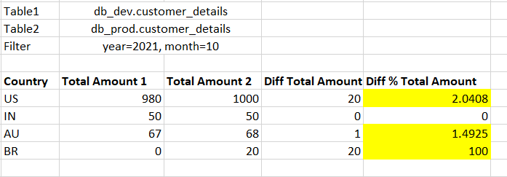


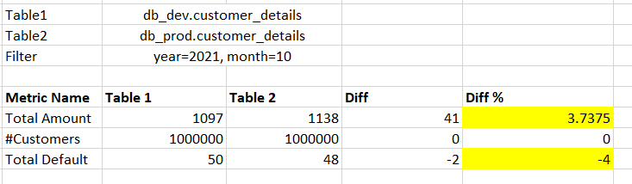

Project 4 : Regression Testing
Why ? :
An automation utility that can be used for an extensive comparison of metrics and dimensions between two hive tables or between baseline data in excel to a hive table. Useful during UAT or migrations.
What’s new ? :
This utility can compare data for all the selected metrics across all the selected dimensions and as it is built using PySpark and python, it has good performance on large datasets as well.
Flow diagram :
Technology Used
Python script uses pandas and PySpark for aggregations
Configs are provided in csv, like :
Hive table names
Metrics and Dimensions
Group by columns if any,
filters if any.
Test results are written as two sheets in excel:
Sheet1: Comparison of metric aggregates along dimension categories
Sheet2: Comparison of overall metric aggregates

Slide 10






Project 5 : MyDramaList Scrapper
2022.08
Why ? :
To generate a comprehensive dataset of the top 500 dramas, that contains general details along with review and reviewer details. Has been uploaded on Kaggle for public use.
What’s new ? :
This data has been scrapped from MyDramaList website and sentimental analysis has been performed using the Hugging Face model. Multithreading and Multi-processing approaches were used to de-crease the time of execution and this script can also run for fetching all the dramas on MyDramaList.
Flow diagram :
Technology Used
Python Modules
Web Scrapping
Content Extractor
Review Scrapper
& Processor
cardiffnlp/twitter-roberta-base-sentiment model from Hugging Face is used
for sentimental analysis of reviews
Drama details are scrapped from MDL page
Scrapped data is processed using python.
Code is available here.
Processed data is written in csv. Dataset can be found
on Kaggle.

Slide 11
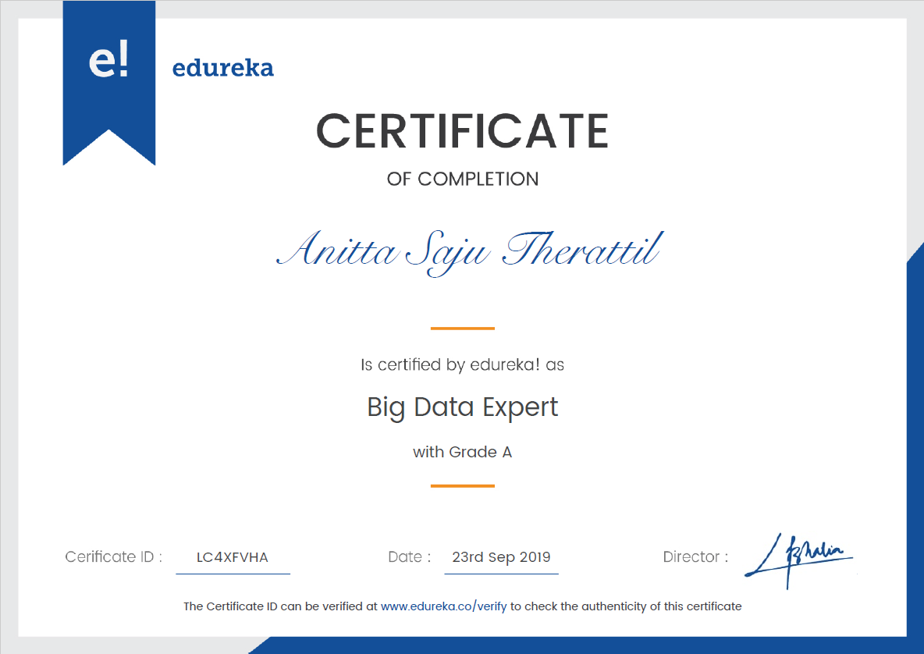
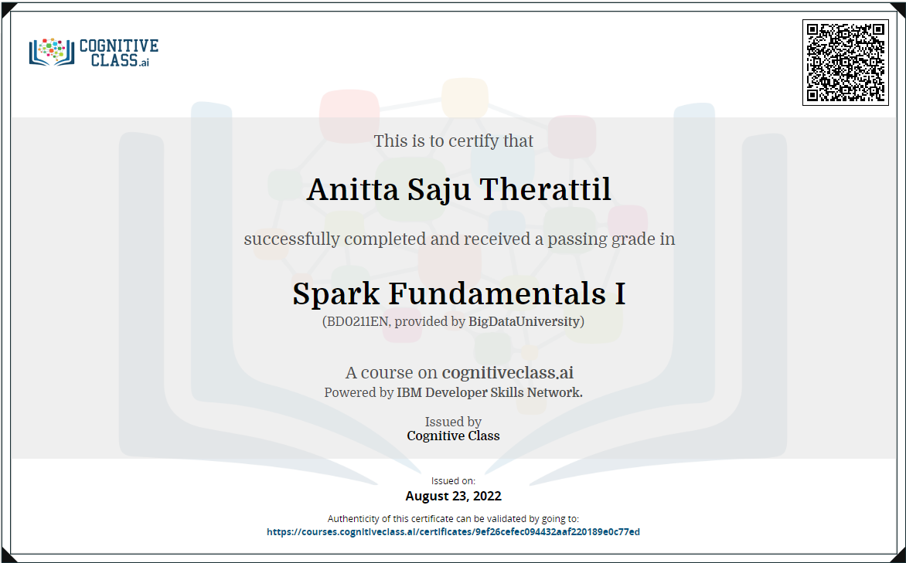
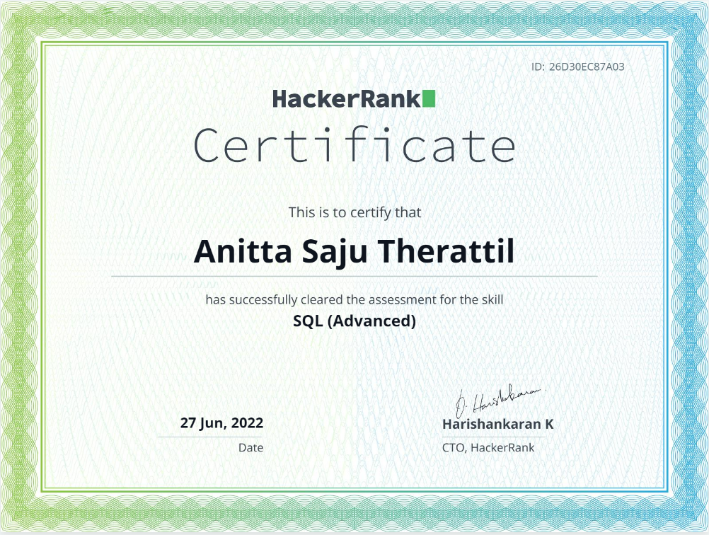
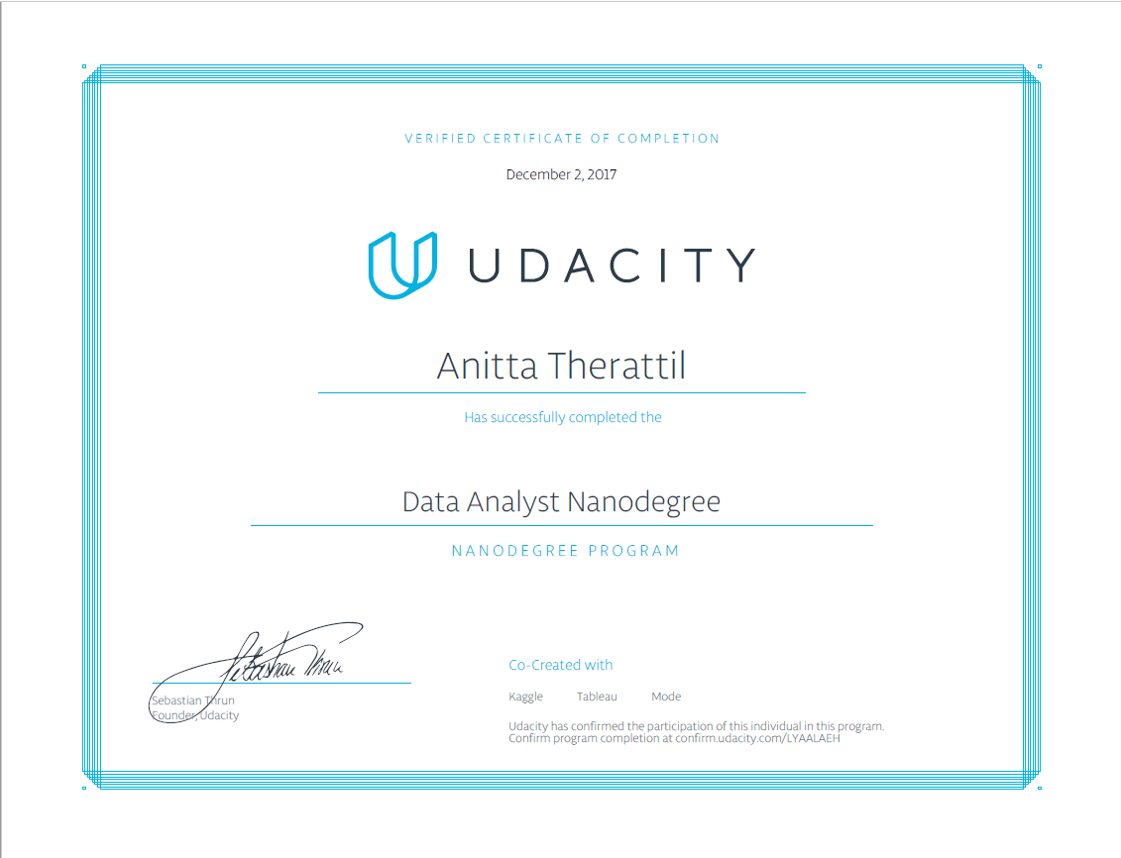
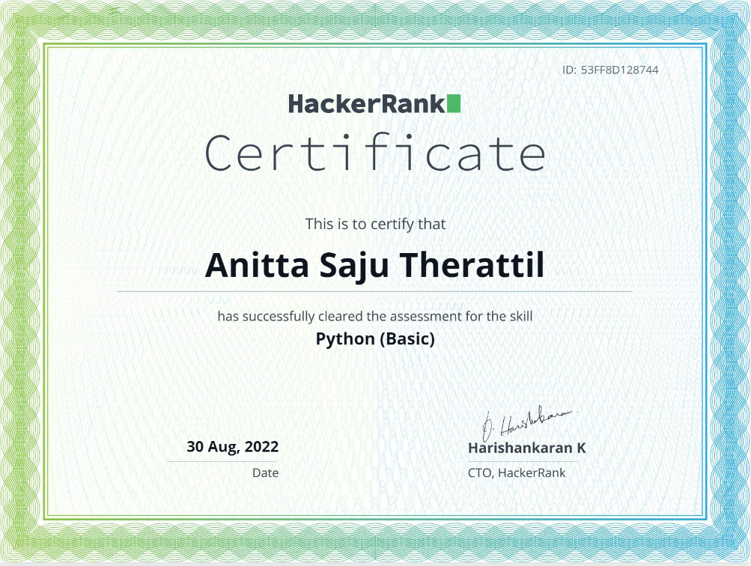

CERTIFICATIONS

Slide 12


Achievements
Leadership in Action Award
Global Education Center Stars Award
Bronze Medalist in Engineering (EC)

Slide 13
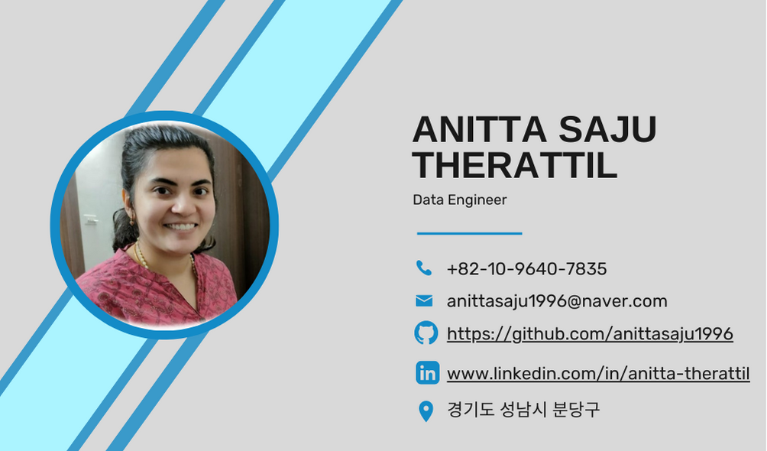
+82-10-9640-7835
anittasaju1996@naver.com
https://github.com/anittasaju1996
www.linkedin.com/in/anitta-therattil
경기도 성남시 분당구

